Slide 1
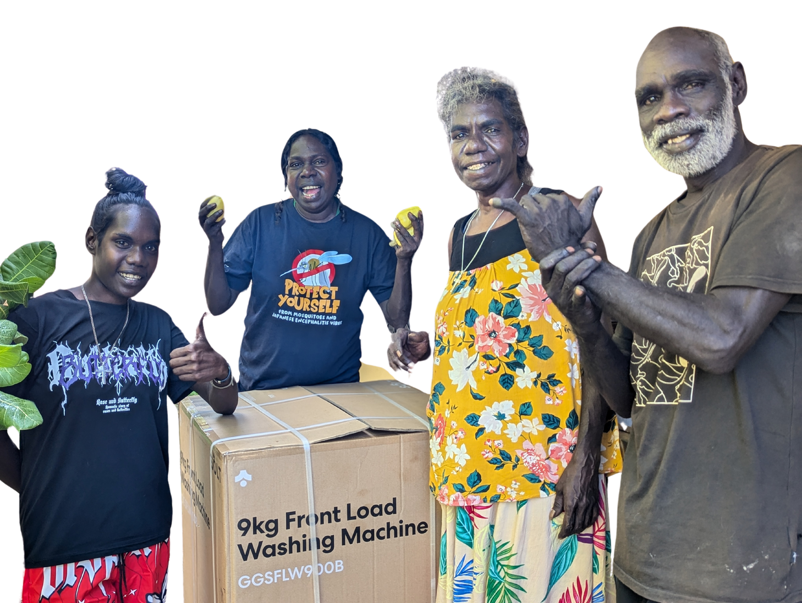

Community: THE HEART OF Engagement

Slide 2

Maningrida is Kunibidji Country
We acknowledge the Traditional Custodians of the lands and pay our respects to Elders past, present and emerging.

Slide 3
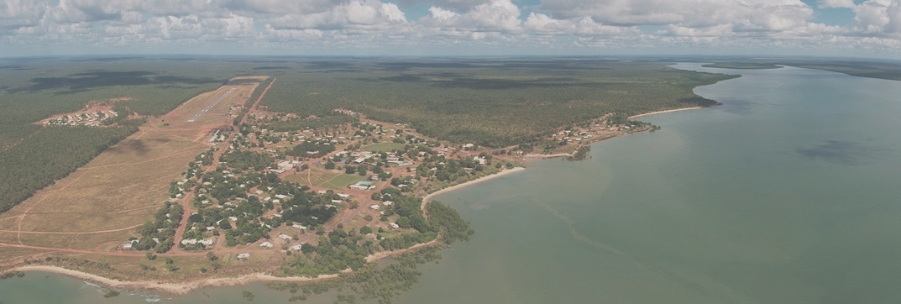
Located in West Arnhem Land Northern Territory 520km from Darwin
Main languages
  Burarra
  Ndjébbana
  Eastern Kunwinjku
  Na-Kara
  Wurlaki
Manayingkarírra
Kunibidji country
3300
13
32
RESIDENTS
LANGUAGES
OUTSTATIONS

Slide 4
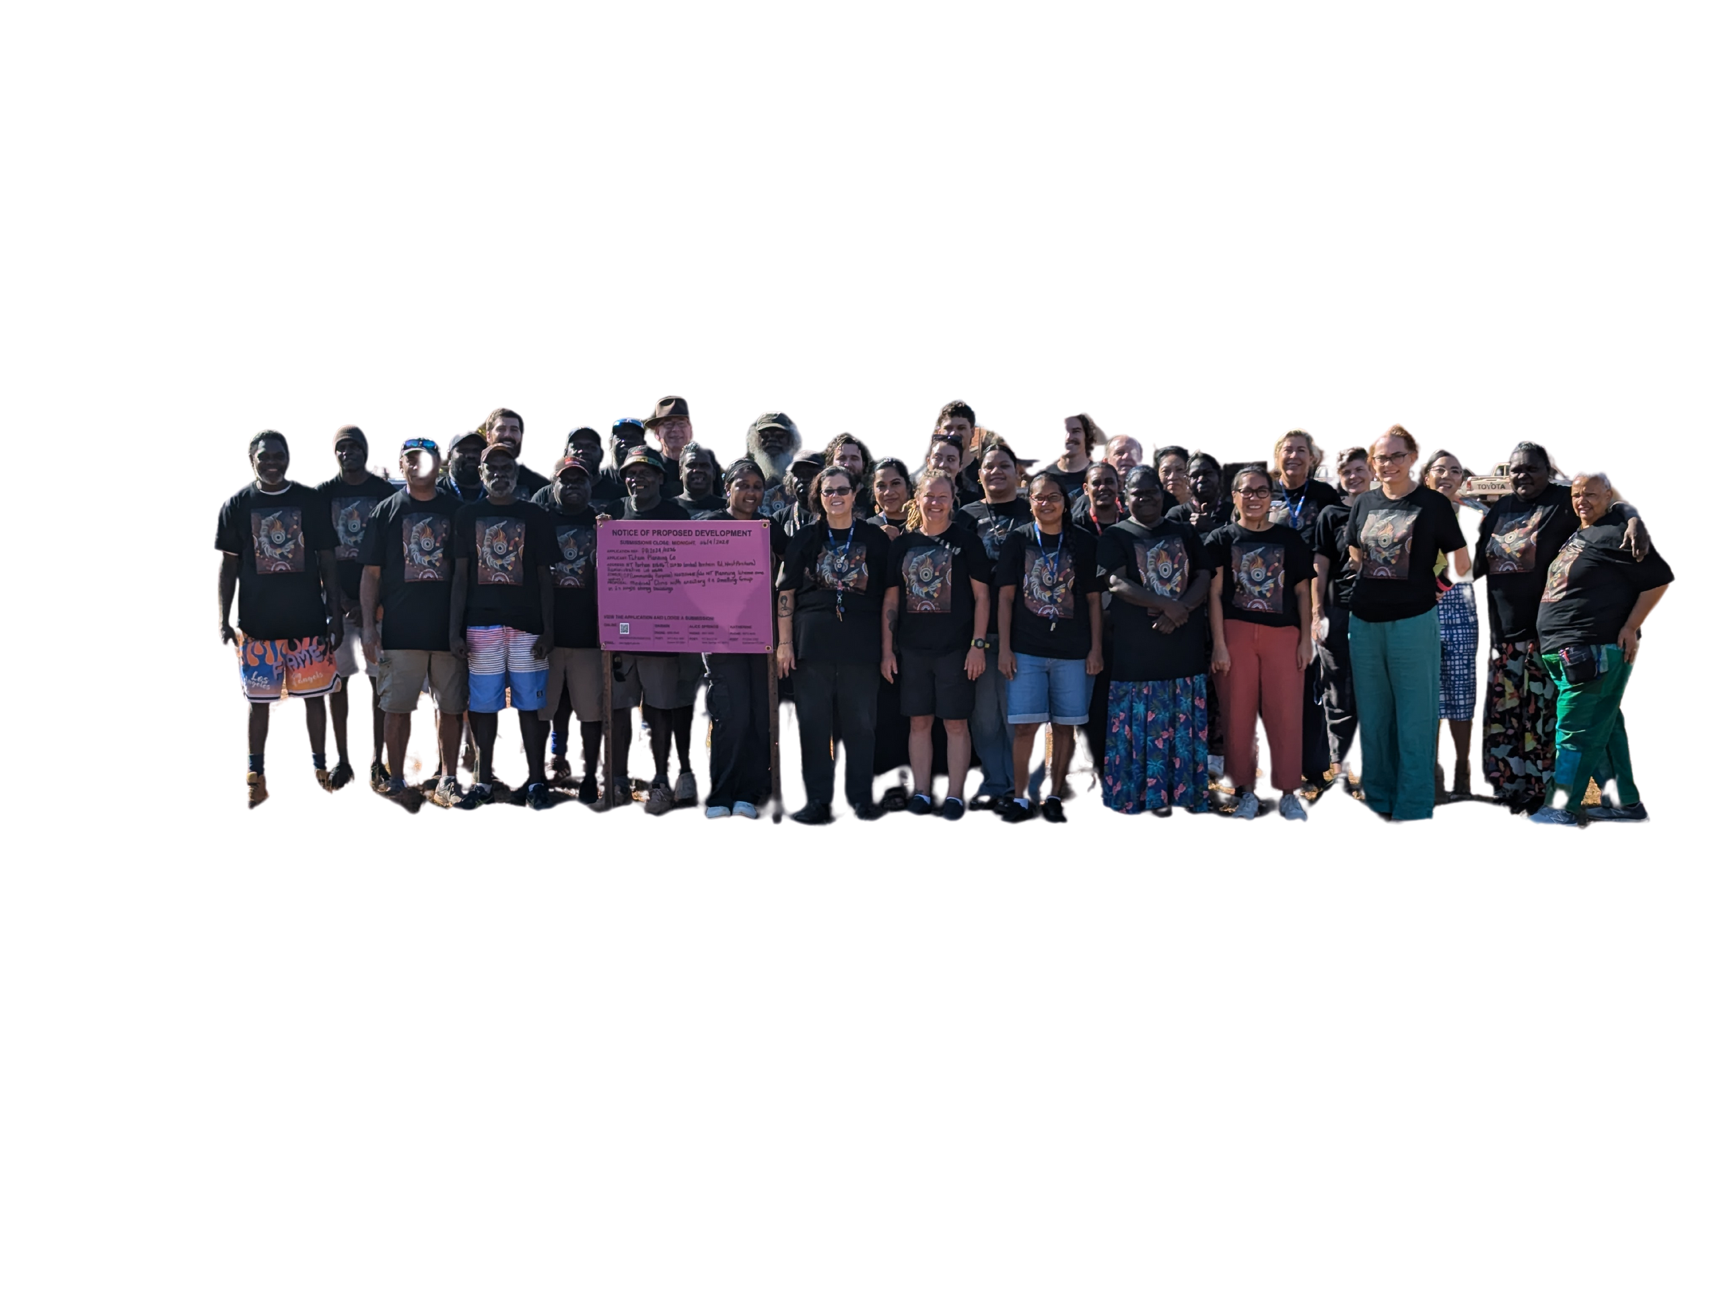
Our Community

Slide 5
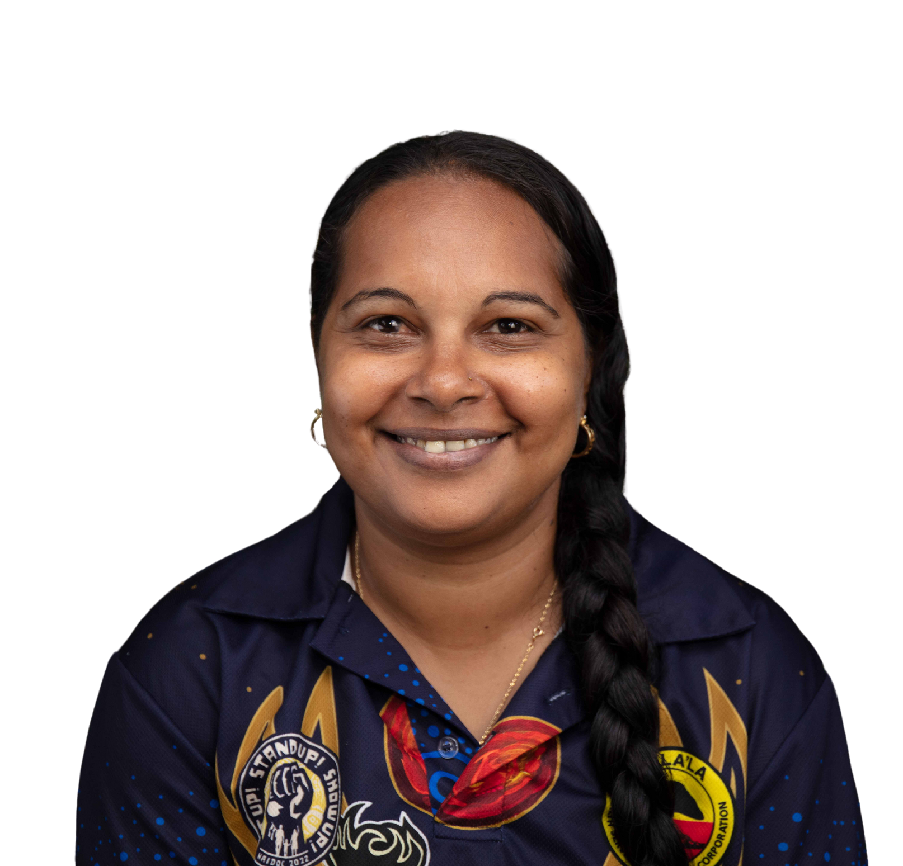
Health Portfolios
Outreach
  Chronic Conditions
  Acute and Emergency
  Women's Health
  Men's Health
  Midwifery
  Visiting Services
  Mental Health
  Orange Sky
  RHD
  Outstation Health
  Child Health
  Healthy Under 5's
  Training & Development
  After Hours
  Vaccine Drives
  Healthy Skin Week
  Youth Health
  Breast Screening/ Women’s
  Contact Tracing

Slide 6
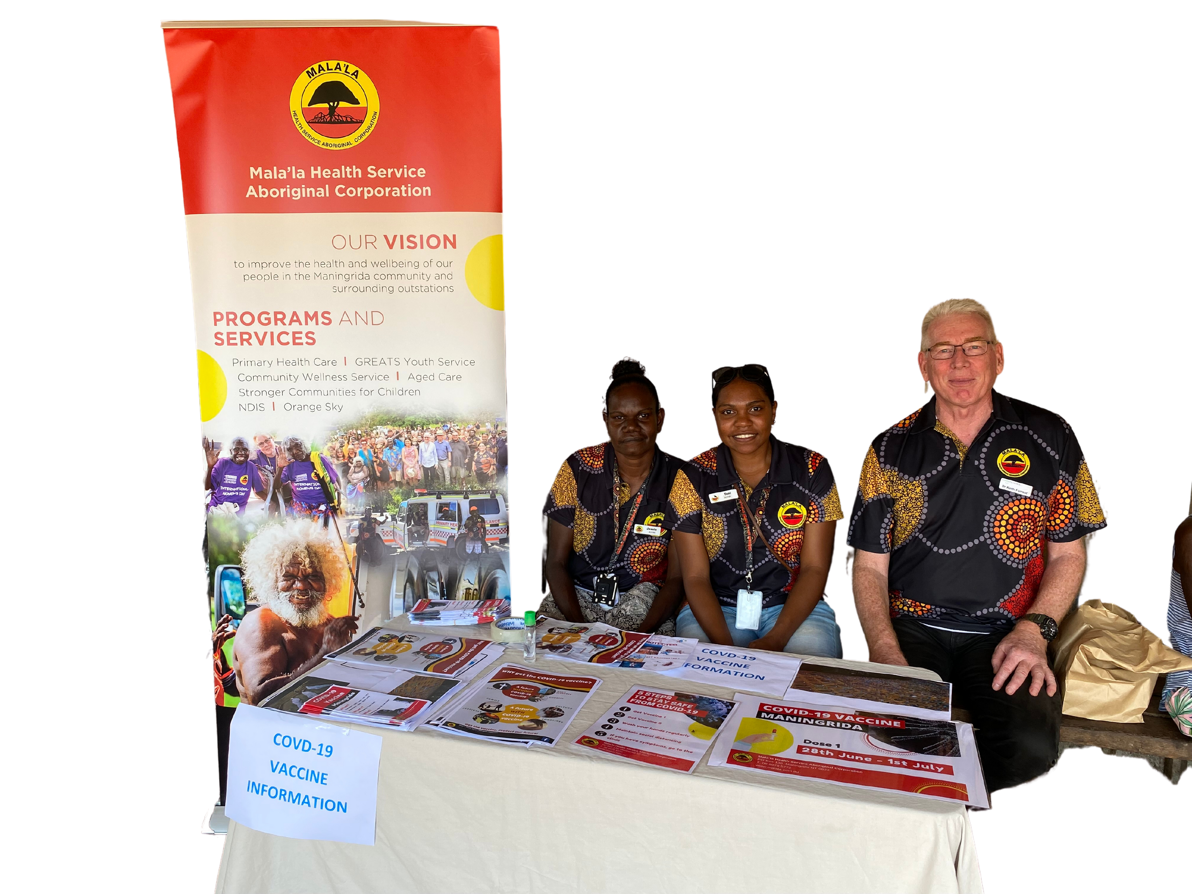
Community Engagement for Outreach

Slide 7
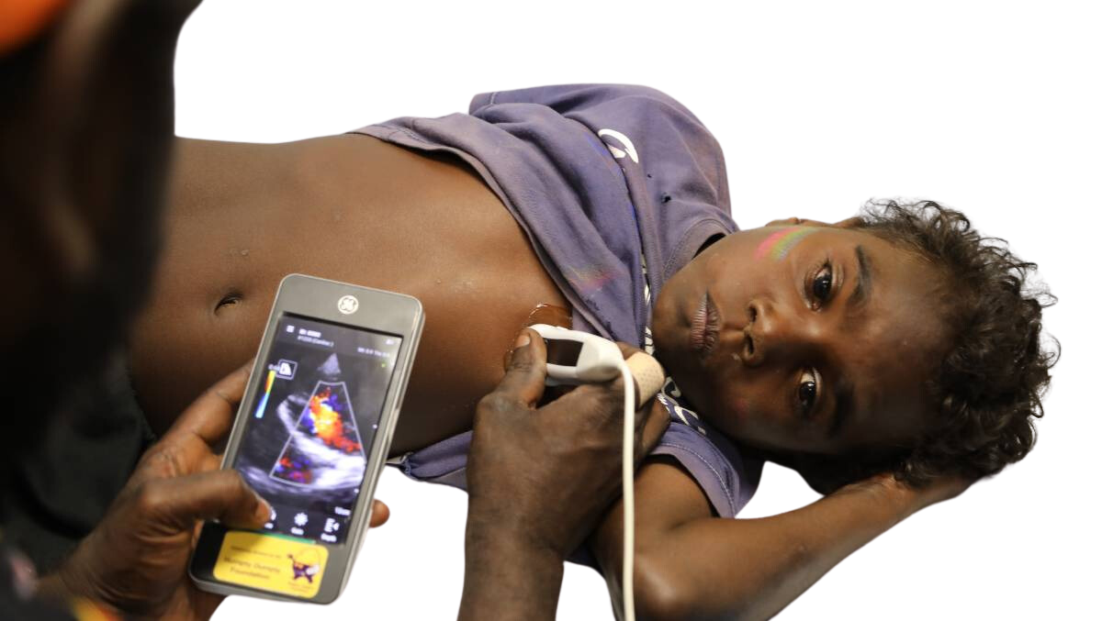
The Focus: How Did it Come to Our Attention
  Community - After Hours
  One off or novel - JEV
  Health Event - Breast Screen
  Internal - Workforce Training
  Local Prevelance - Scabies; Tuberculosis
  From Data - KPI: STI screening
  Research: collaboration potential - SCIP; NEARER

Slide 8

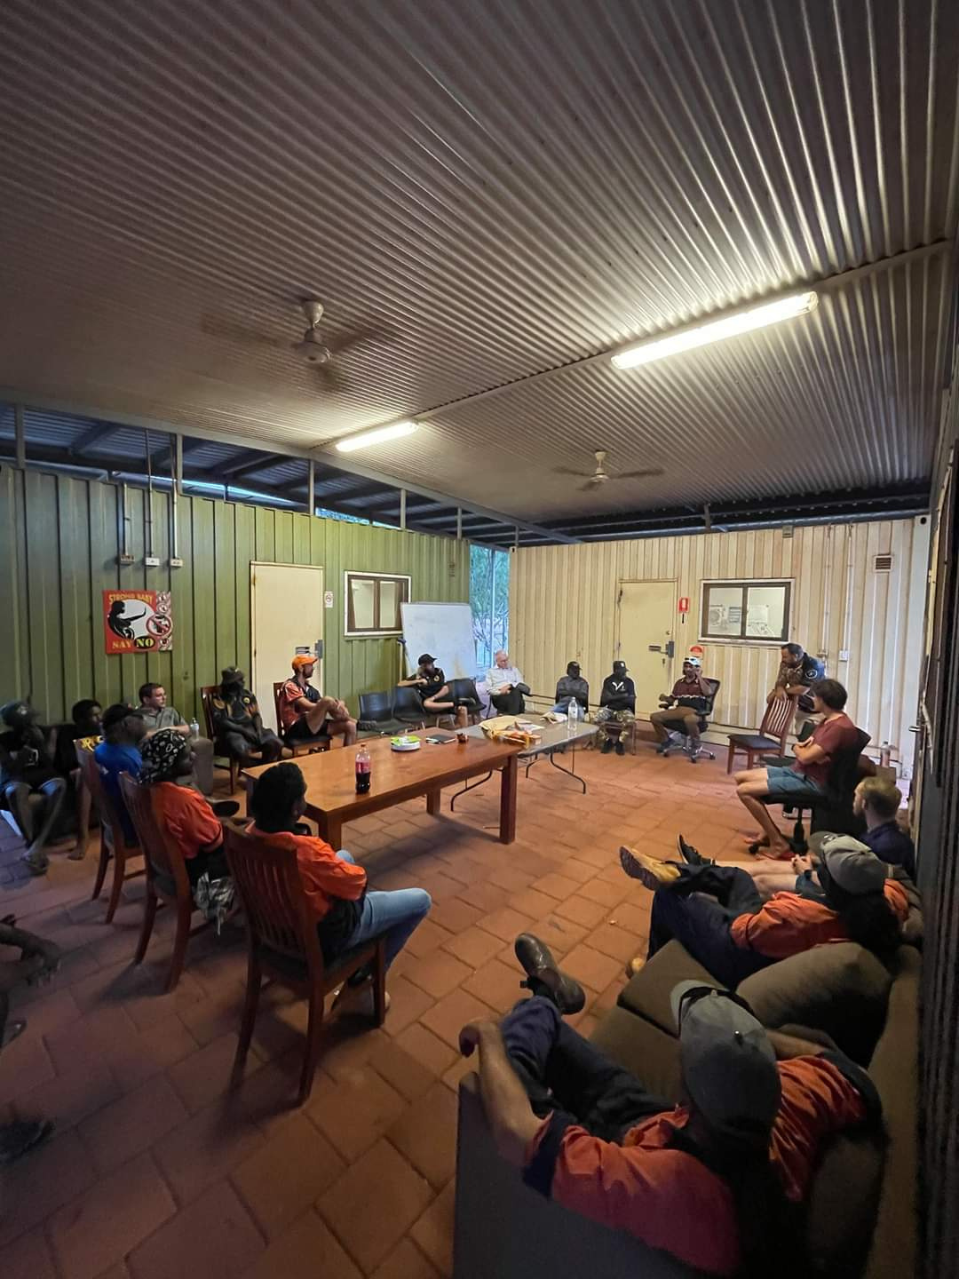
The Consultation: Starts with Conversations
Discussions
  Community Groups
    HOA
    Leadership
    Individual Leaders
    Women’s & Men’s
    Organisations
  Community Workers
    Whats the baseline understanding
  Clinical Staff
    Skill mix
    Current understanding
  Visitors
    Helping with delivery
    Providing education/resources

Slide 9
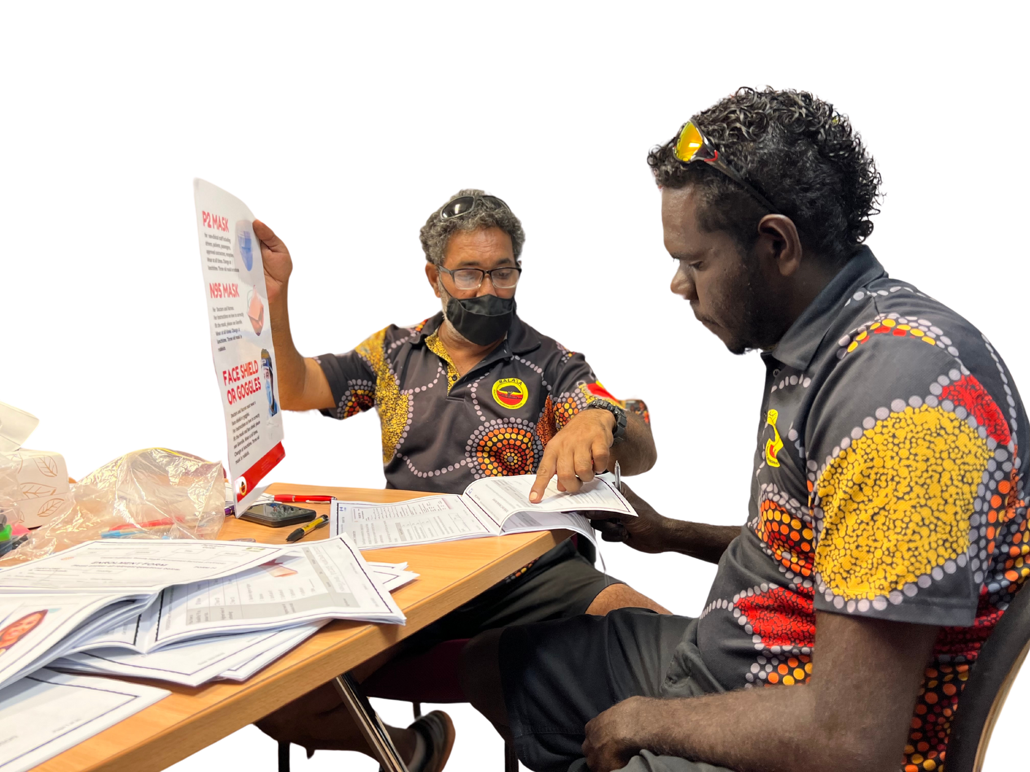
The Planning: Well in advance
Internal
  Money
    Program funding
    Sourced funding
  Ordering Supplies
    Office supplies
    Medications
    Consumables
    Uniforms
  Overcoming Remoteness
    Weather
    Staffing
    Travel

Slide 10
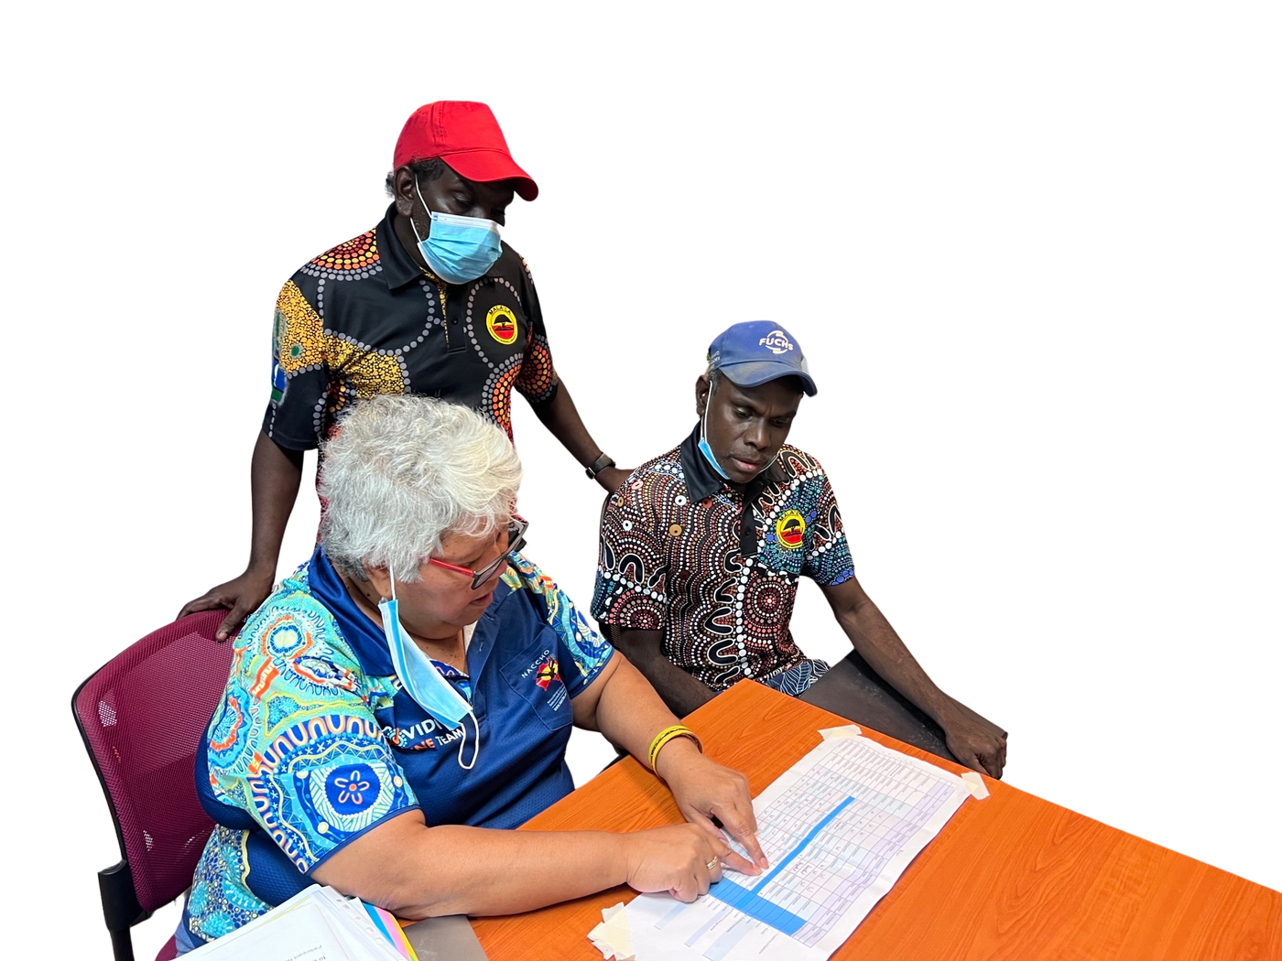
The Planning: Well in advance
Community
  Dates
    Other community events
    Availability of Community Stakeholder Staff
  What supports can we offer?
    Information Sessions / Workshops
    Workplace pop-up Clinic
  What supports they can offer?
    Sponsorship (be specific!)
    Resource Development
    Host an Information Session
    Bring their Staff and Clients to the Mobile Site

Slide 11
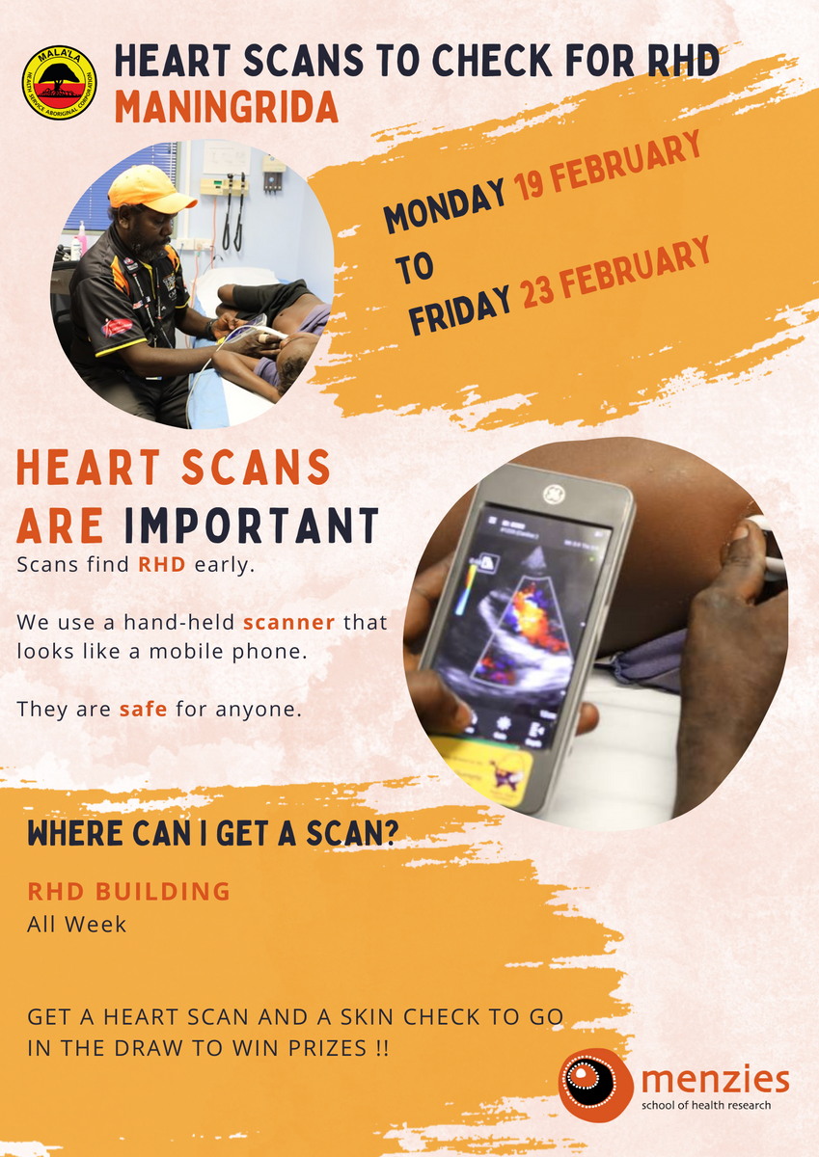
The pre work: Developing Resources
  What Resources do we Need to Develop or Source?
    Workshops
    Conversations with Cultural Advisors
    Community Group Consultation
  Start Developing templates and materials

Slide 12
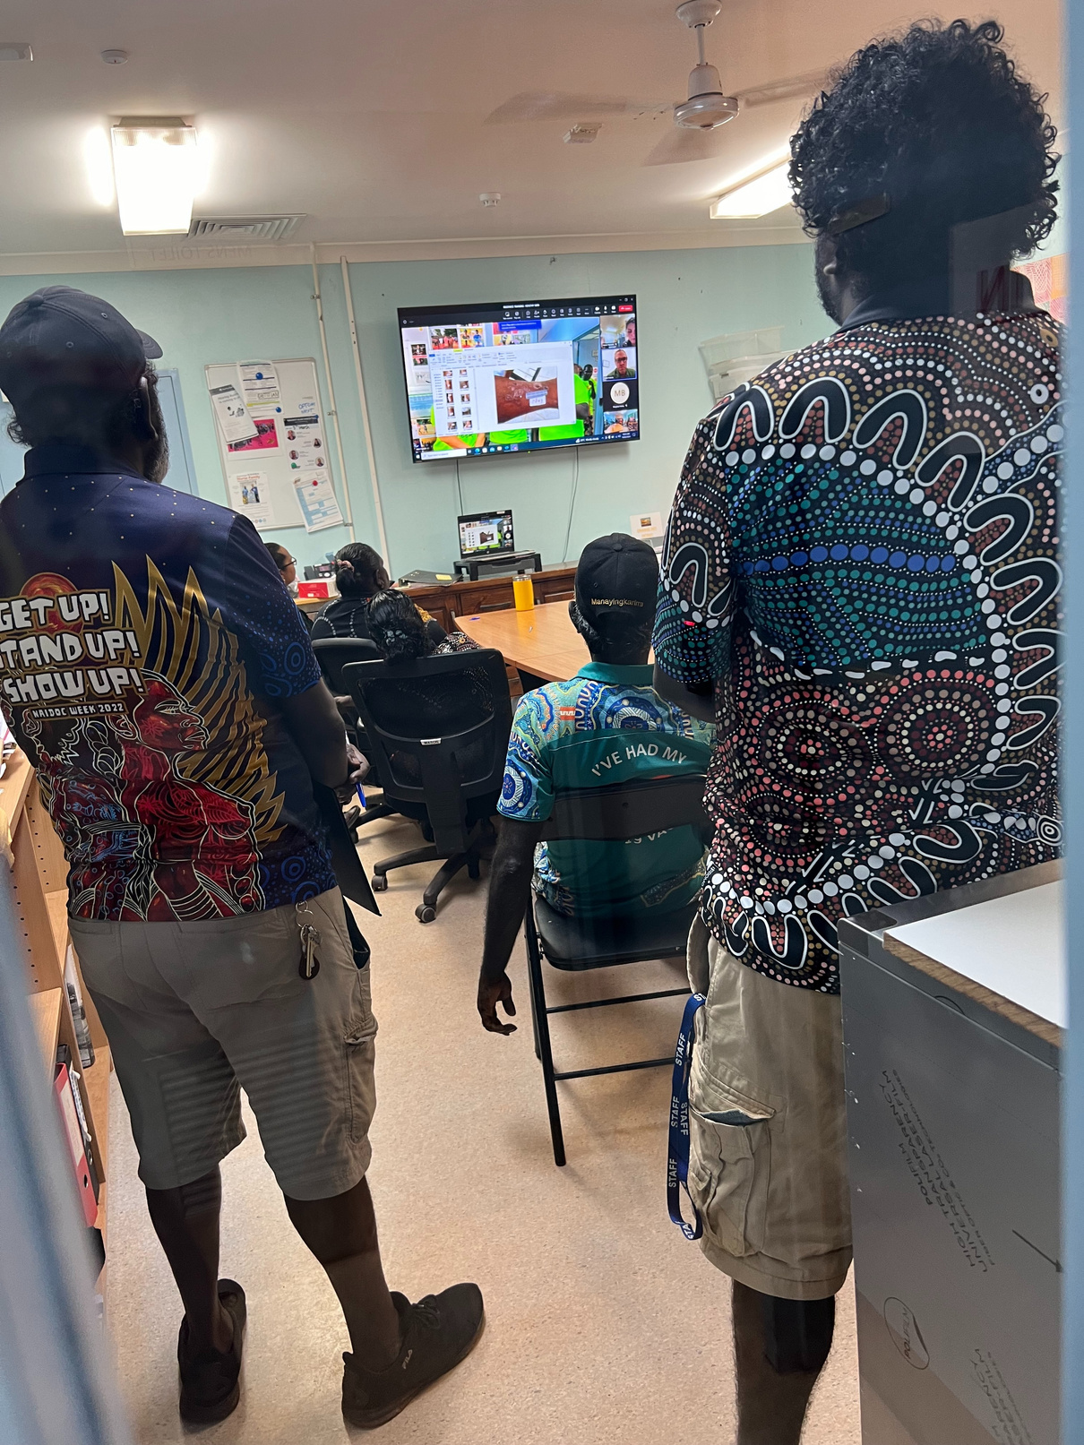
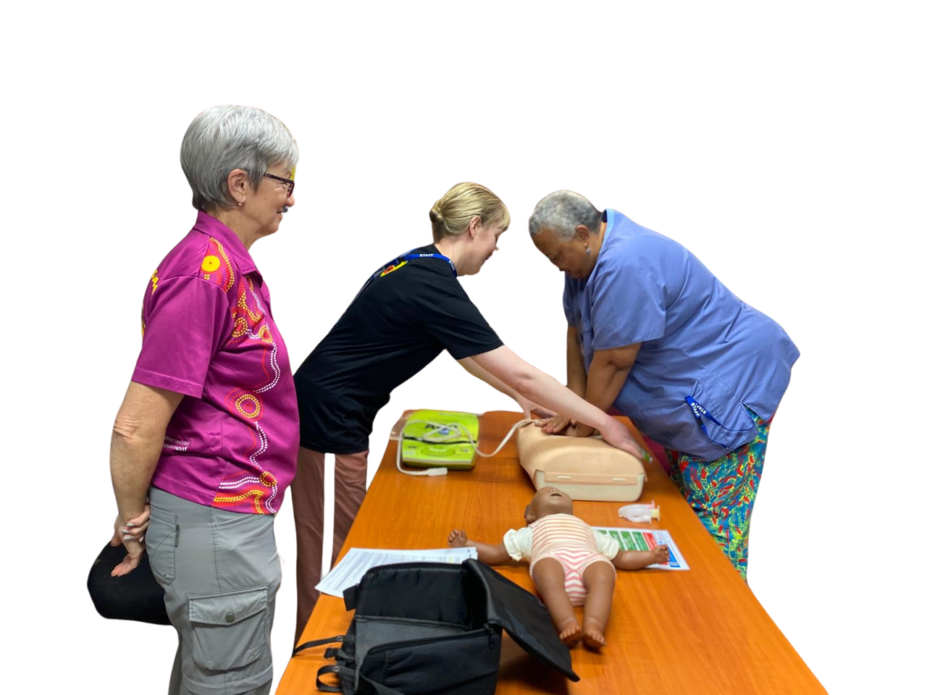
The pre work:Training
Workshops and Training
    Community Workers
    Clinical Staff
    Partners in Delivery

Slide 13
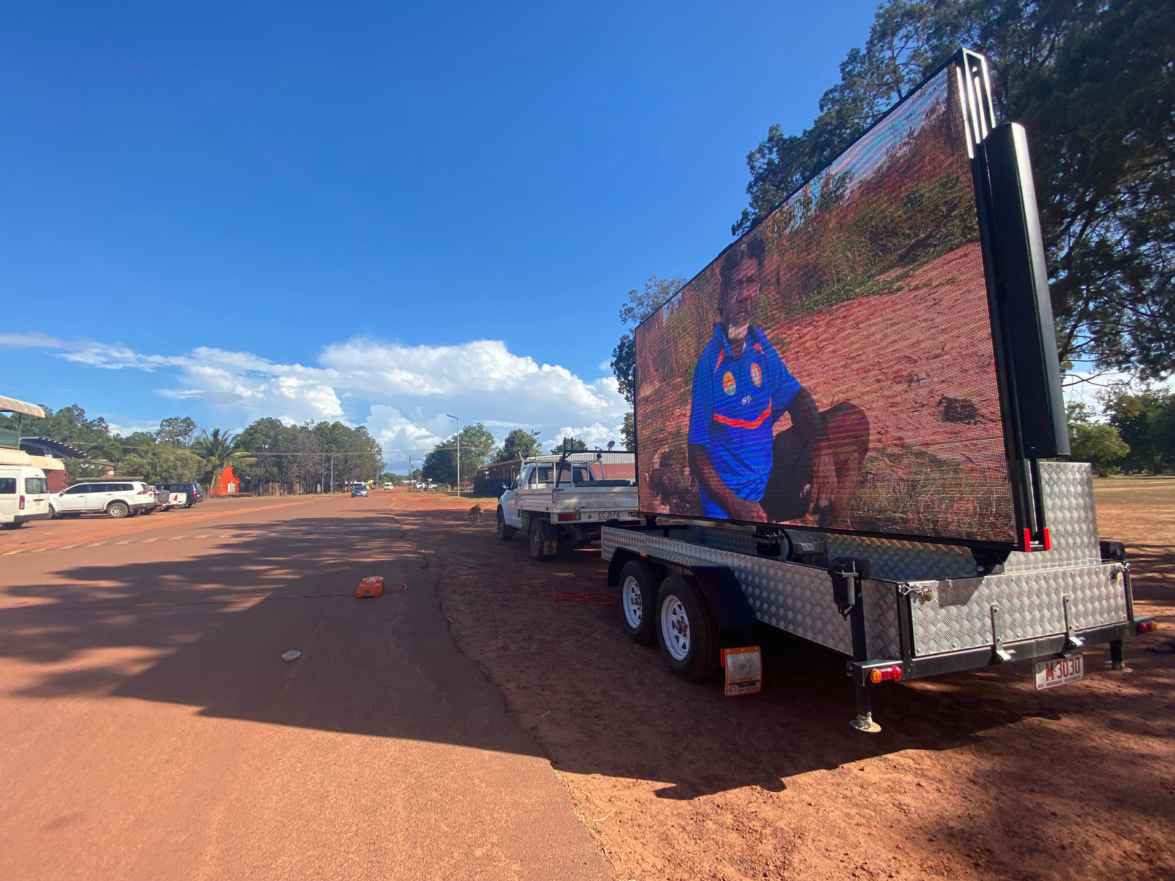
The pre work: Templates and Materials
  Informing Community/ Comms
    Posters
    Facebook
    Videos
  Maintaining Staff Awareness
    Posters in Clinic
    Morning Meetings
  Rosters
    Self Nomination
    On-call
    Funerals
    Continue to Staff Programs
  Car Kits
  Offline Communicare
  Population Lists
  Fact Sheets

Slide 14
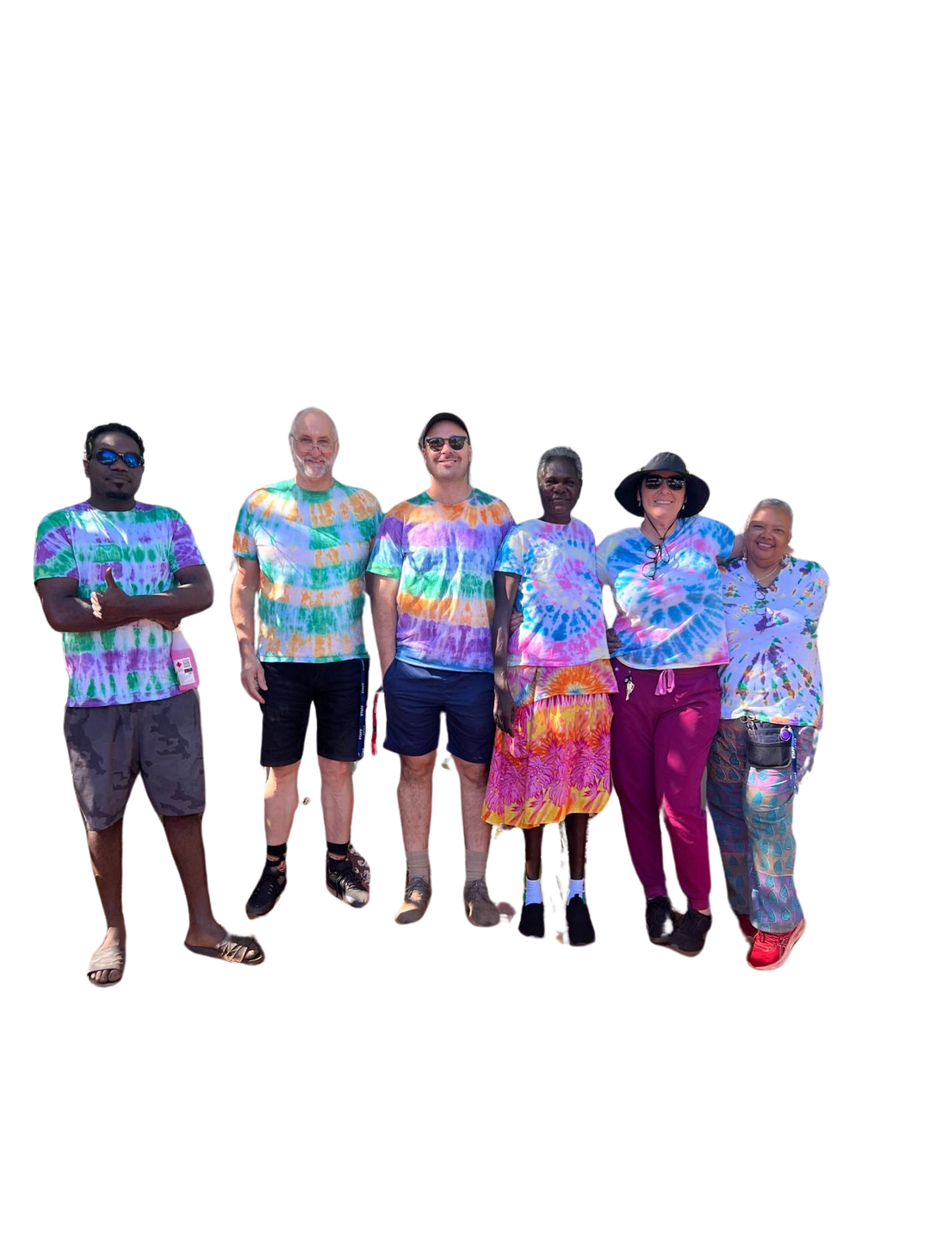
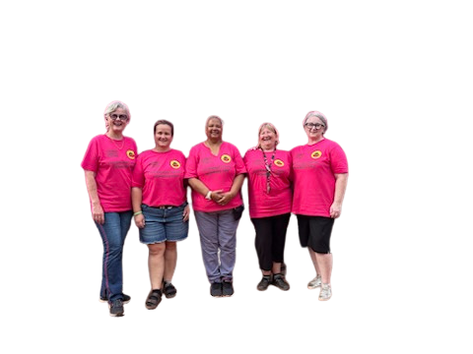
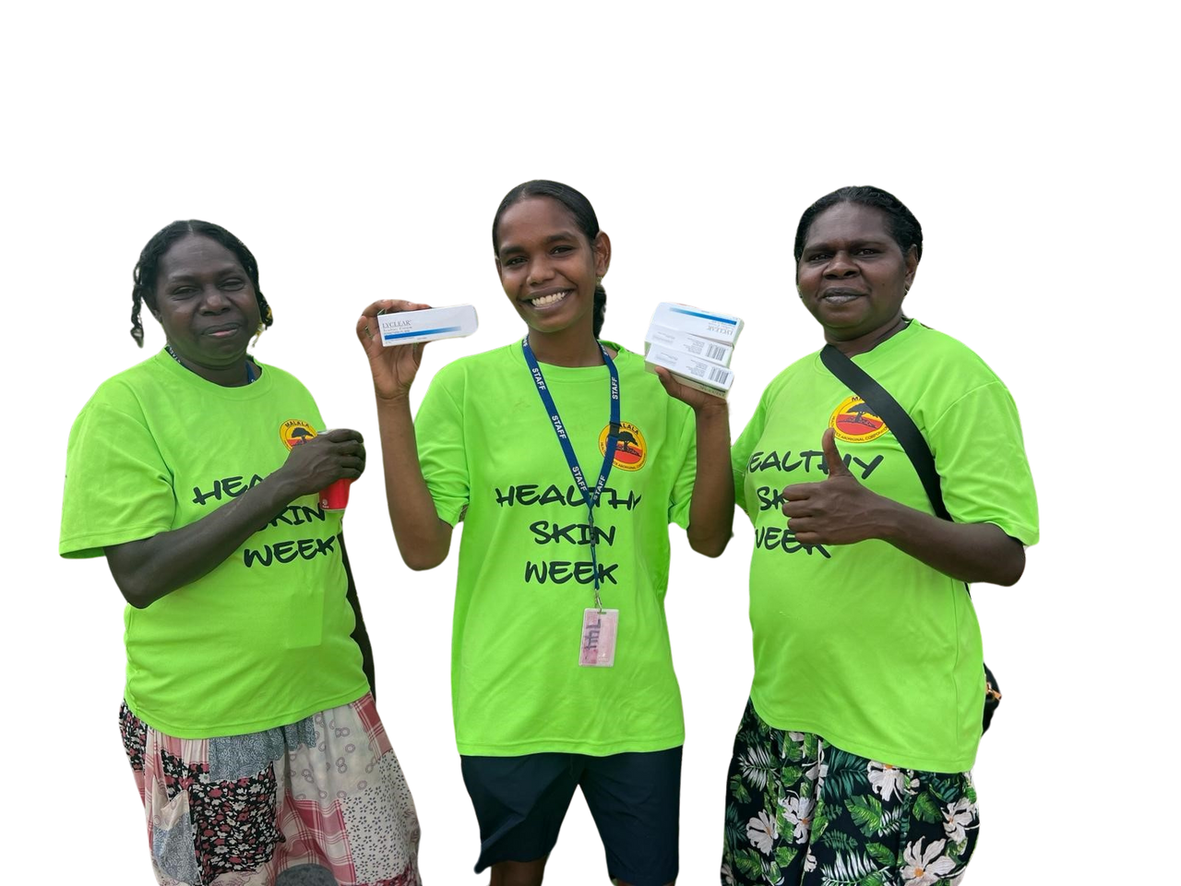
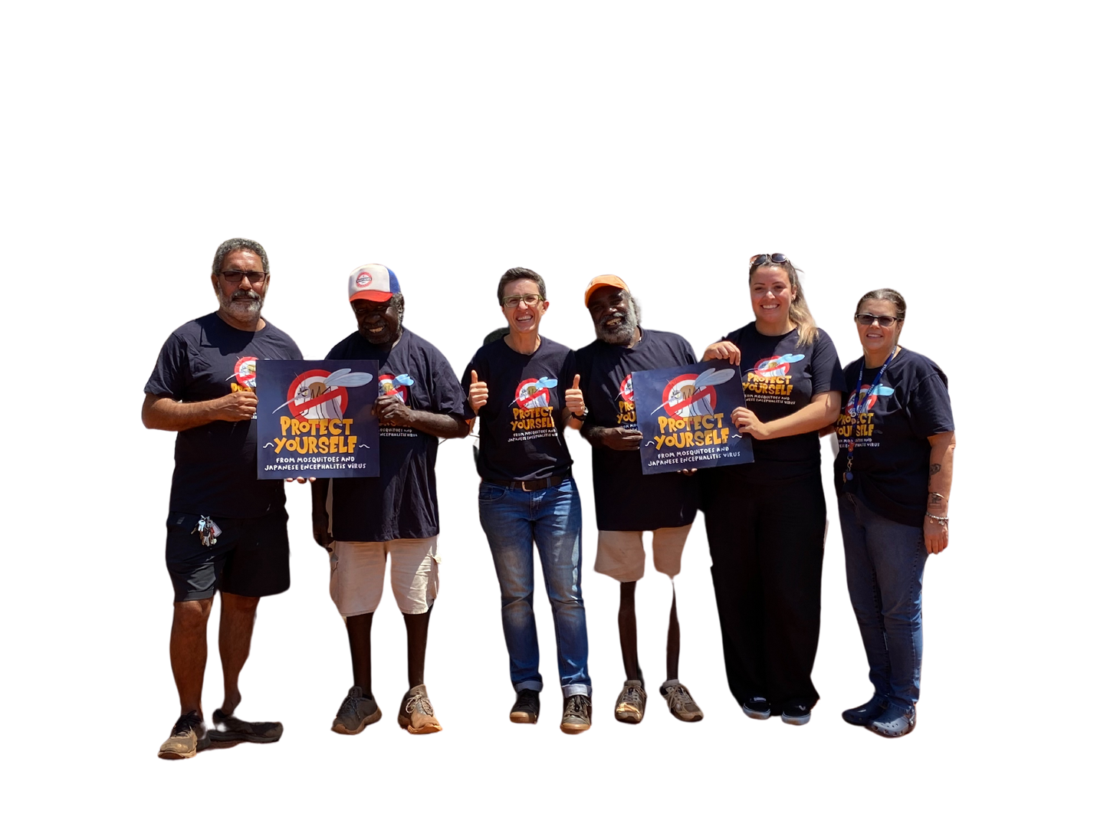
Recognisable

Slide 15


Recognisable

Slide 16
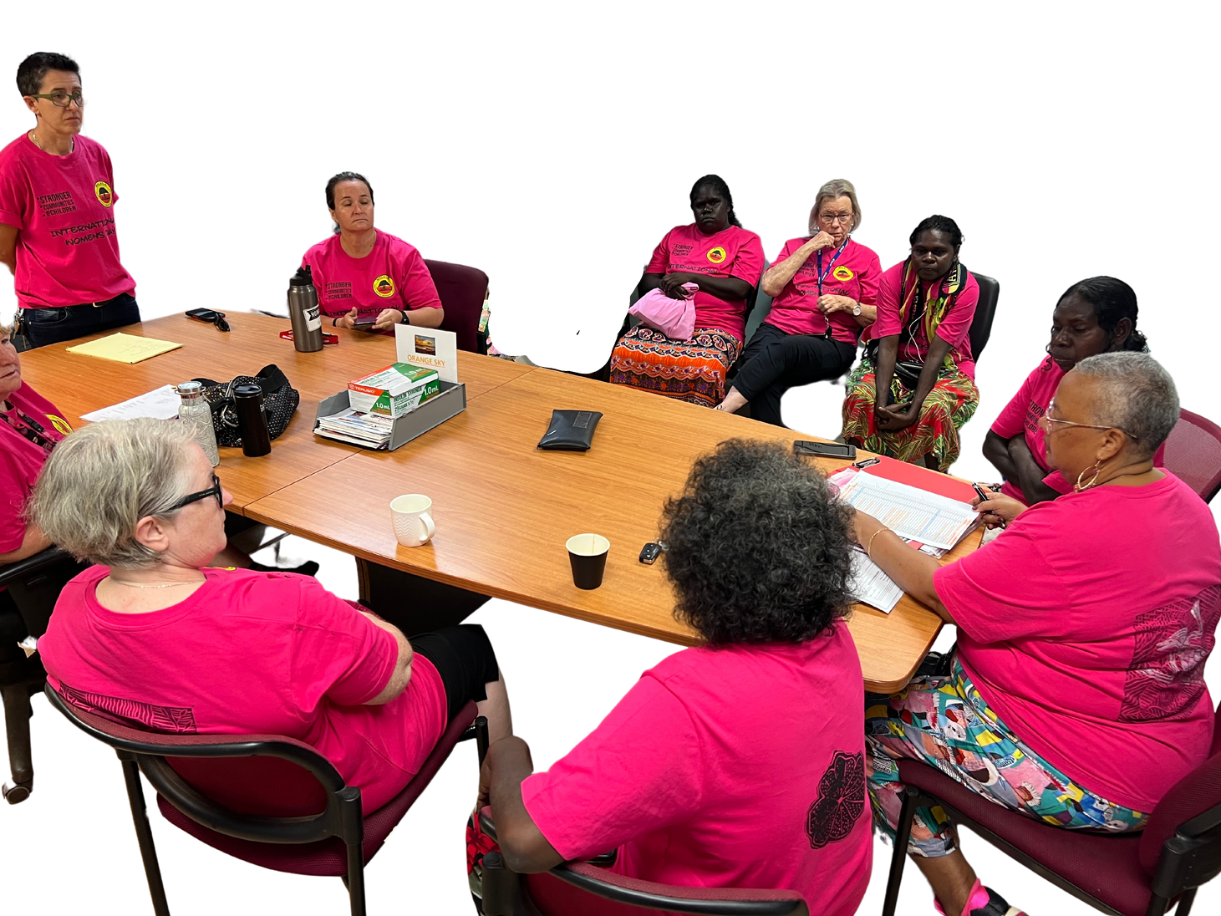
The Roll Out: During
  FOOD!!!
  Weather Flexibility
  Daily Briefing & Debriefing
  Dedicated Room for Operations
  Continue Communication with Community
    Daily Prizes
    Progress
    Specific Requests by Community

Slide 17
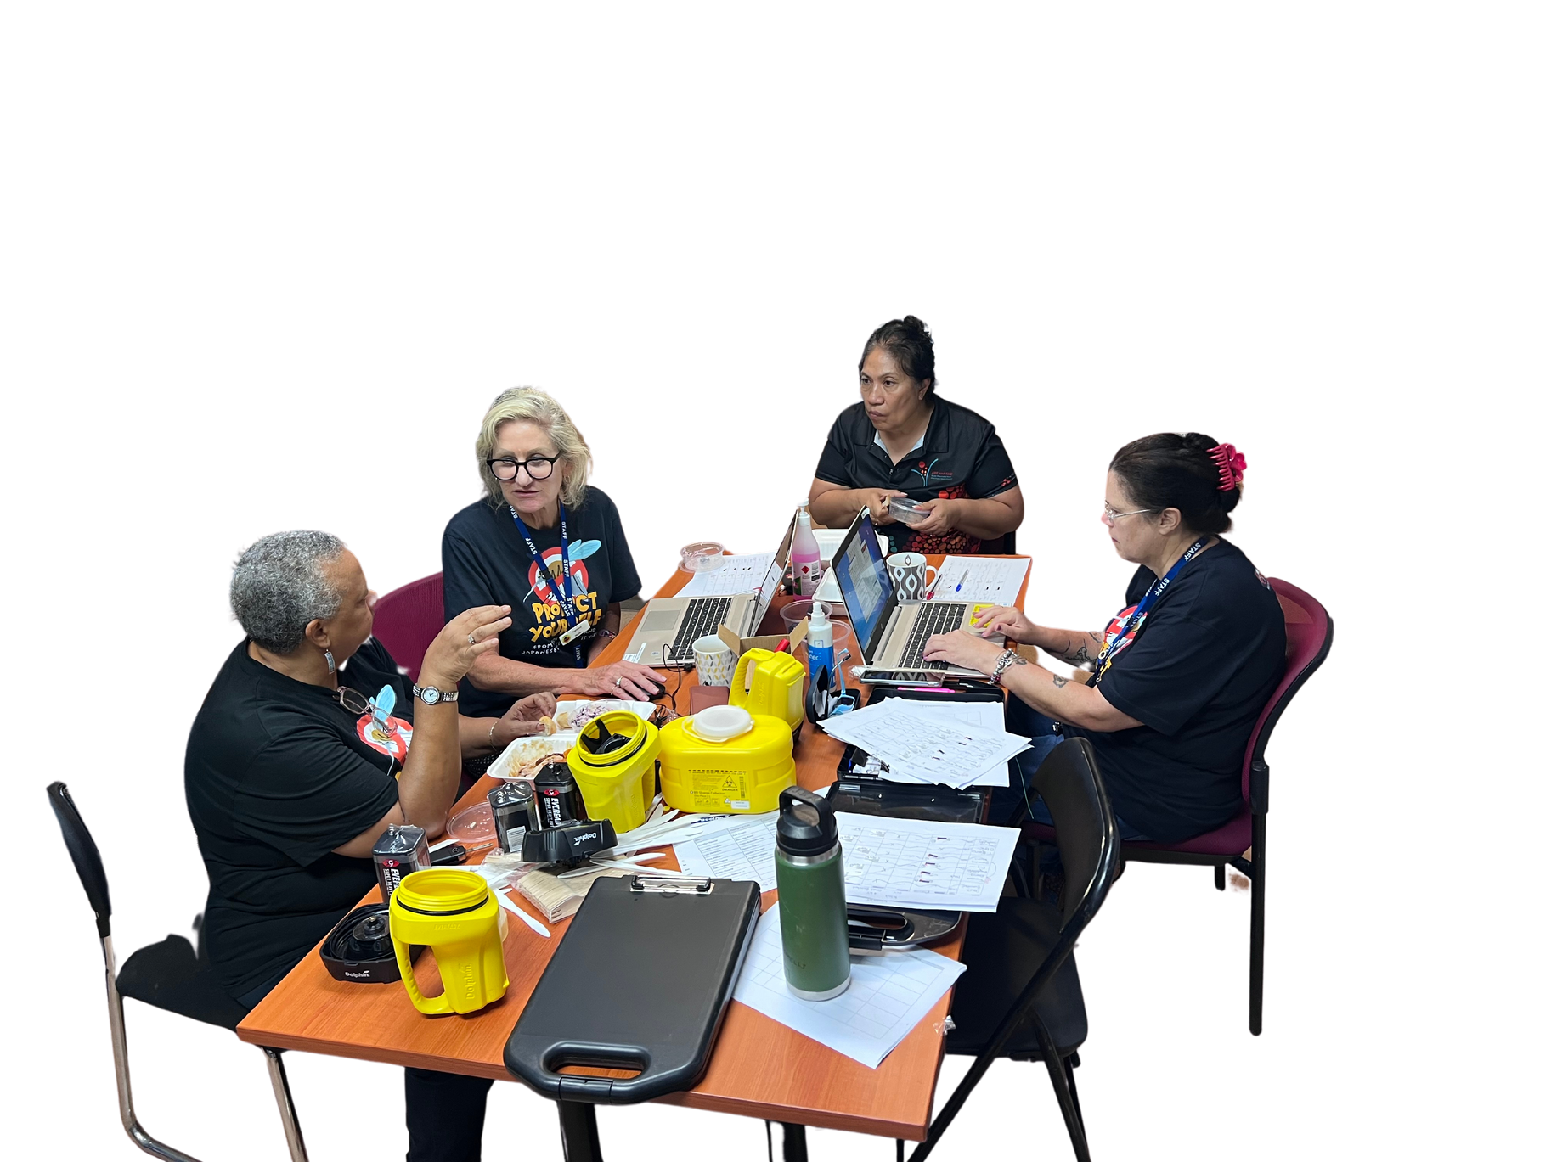
The Roll Out: Essentials
  Data Entry
    Before End of Day
  Replenish Kits
  Group Communication
  Always Have a Runner

Slide 18
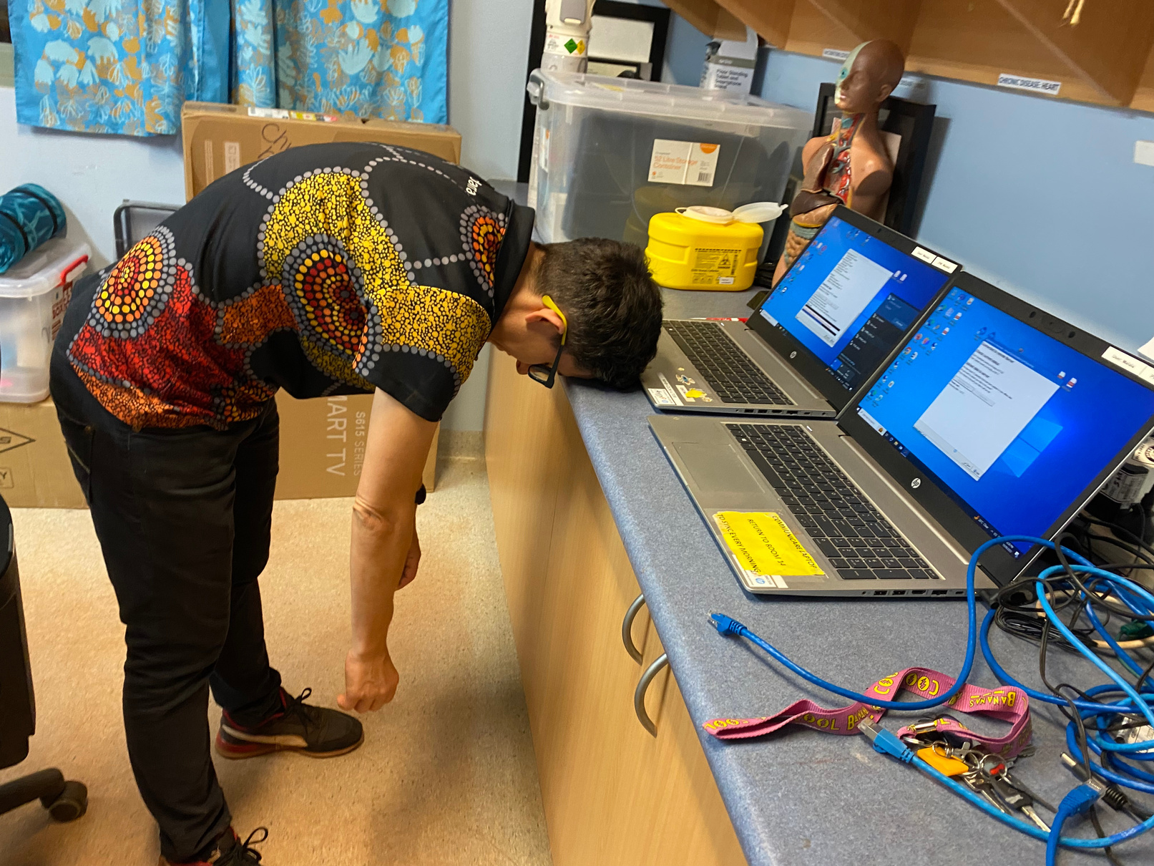
The Roll Out: Essentials

Slide 19
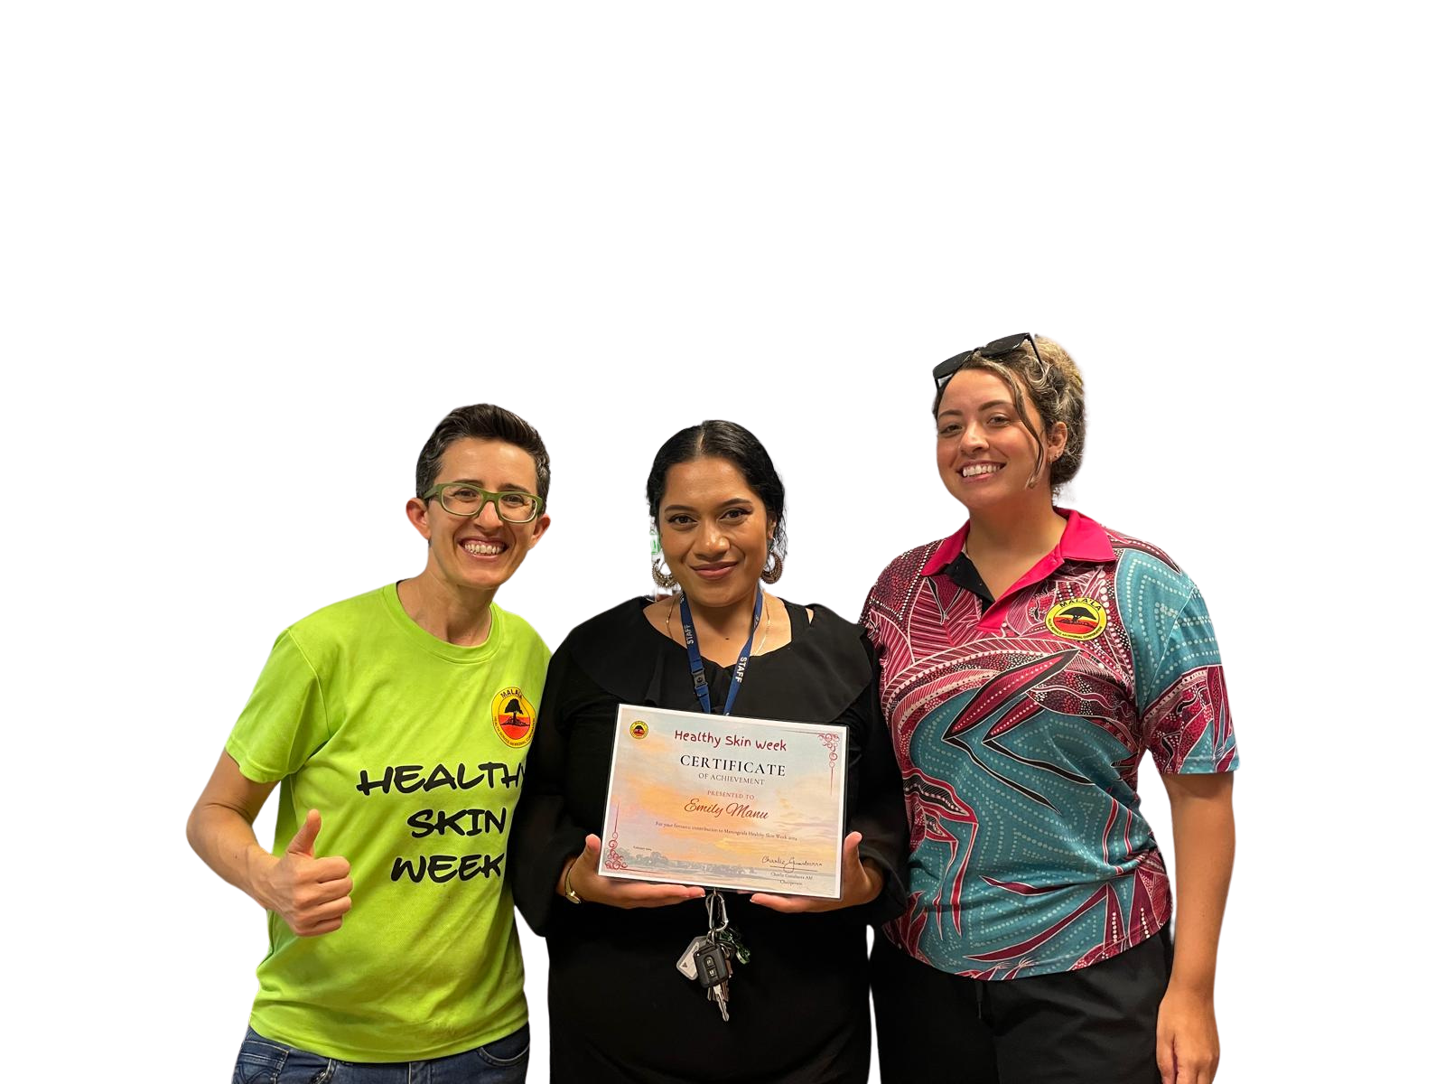
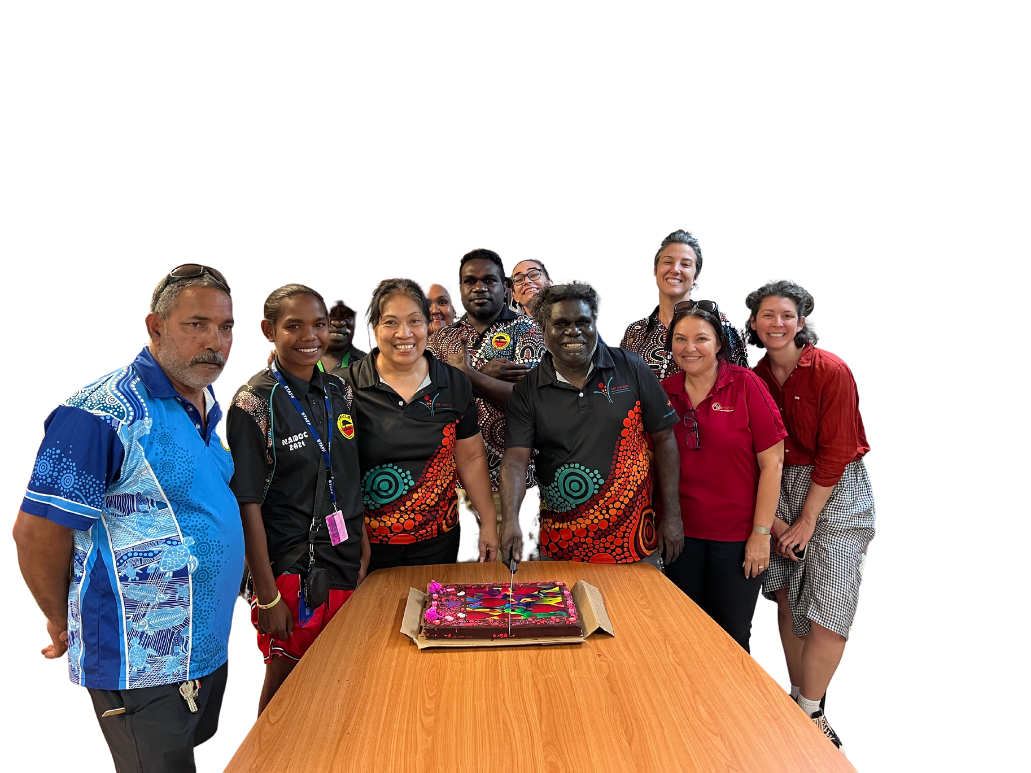
Feed-Back

Slide 20
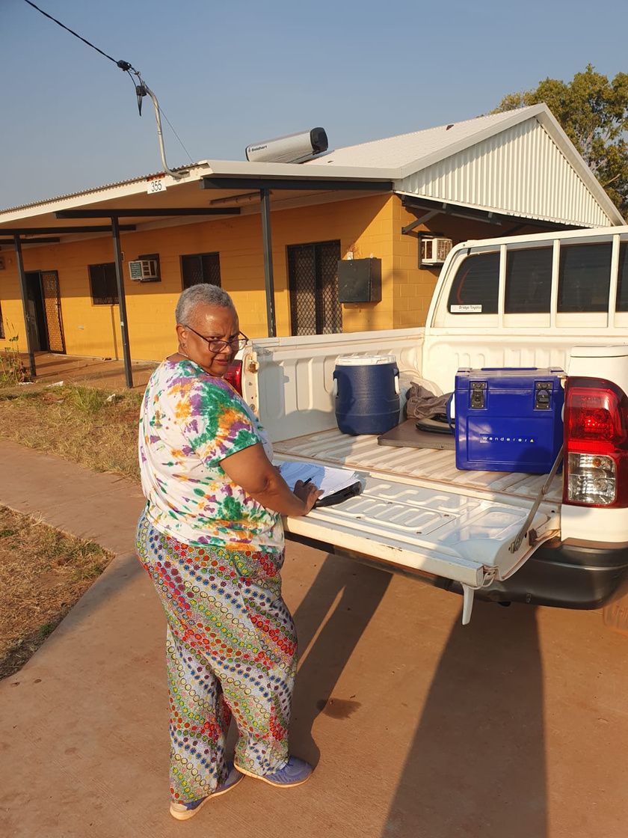
Key Points
  Consistent Model of Consultation and Delivery
  Predictable to Community
  Shirts and logos
  Flexible Delivery
  Feedback Loop - Briefing & Debriefing
  Comms (Posters; Flyers; Facebook)
  Meaningful Inductions
  All Staff Involvement

Slide 21
thank you

