Slide 1
Sharing Stories About What’s Working Well in Immunisation

Slide 2
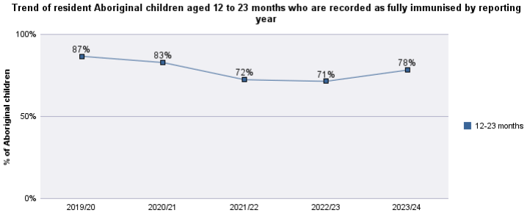
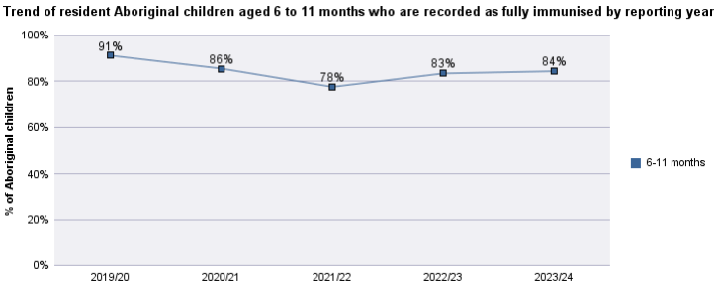
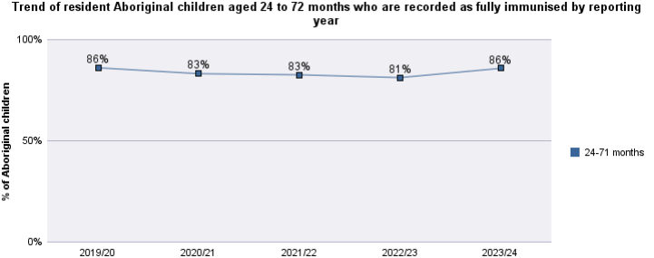
Immunisation Coverage – NTAHKPIs June 2024
NTAHKPI KPI Public Report
June 2024

Slide 3
Service or System Strengthening
Eg: Prioritisation
Cold chain and Vaccine supply
Recall systems
Data and reporting
Supporting staff
Eg: Accreditation
Training
Mentoring/Support
New immunisers
Less confident Immunisers
Community and Clients
Eg: Trust
Education
Demand
Health promotion
Vaccination Delivery and Access
Eg:Opportunistic/Blitzes
Vaccine streams
Alternate sites
Afterhours/ weekends
Innovations:
Eg: Solutions that combine different areas
Resources
Other innovations

